Slide 1
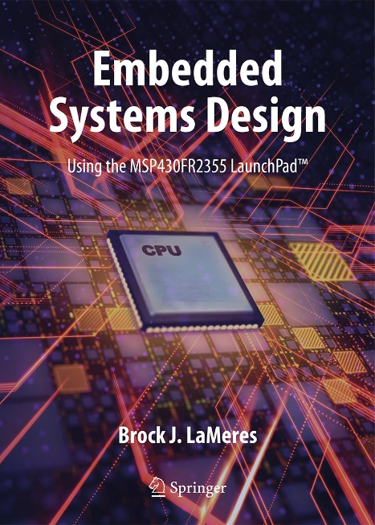

Embedded Systems Design
Chapter 7: Data Manipulation Instructions
7.1 Arithmetic Instructions (ADD)
Brock J. LaMeres, Ph.D.

Slide 2
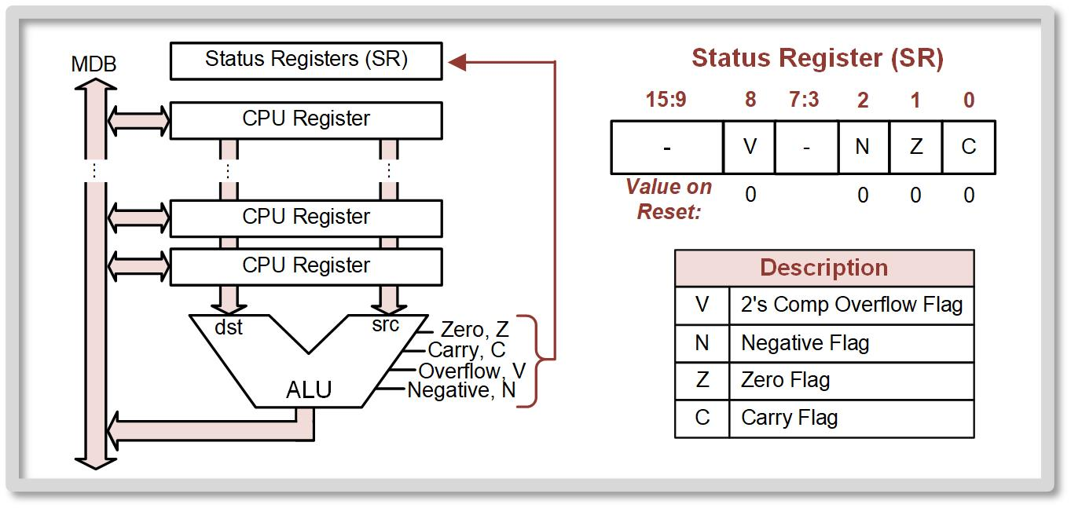
Ch. 7: Data Manipulation Instructions
7.1 Arithmetic instructions
The ALU can be thought of as a collection of combinational logic circuits, each that can perform a desired operation on the data coming from the CPU registers.
7.1 Arithmetic Instructions

Slide 3
Ch. 7: Data Manipulation Instructions
7.1 Arithmetic instructions
For every operation that is desired when designing the CPU, a new circuit is inserted into the ALU.
The output must be put into either a CPU register or memory.
7.1 Arithmetic Instructions

Slide 4
Ch. 7: Data Manipulation Instructions
7.1 Arithmetic instructions
ALU has circuits that monitor the operations and produce status flags (or status bits) which are stored in the status register.
The flags are two’s compliment overflow (V), negative (N), zero (Z), and carry (C).
These flags are asserted when the condition exists.
The carry flag can also be used to indicate a borrow when performing subtraction.
7.1 Arithmetic Instructions

Slide 5

Ch. 7: Data Manipulation Instructions
7.1.1 Addition instructions
add – performs binary addition on two inputs, the src and dst, and puts the sum back into the dst.
Operation can be performed on both 8-bit and 16-bit words by appending .w or .b .
This operation works the same regardless of whether the src or dst are treated as unsigned or signed numbers.
Image Courtesy of https://neodem.wp.horizon.ac.uk/
7.1 Arithmetic Instructions

Slide 6
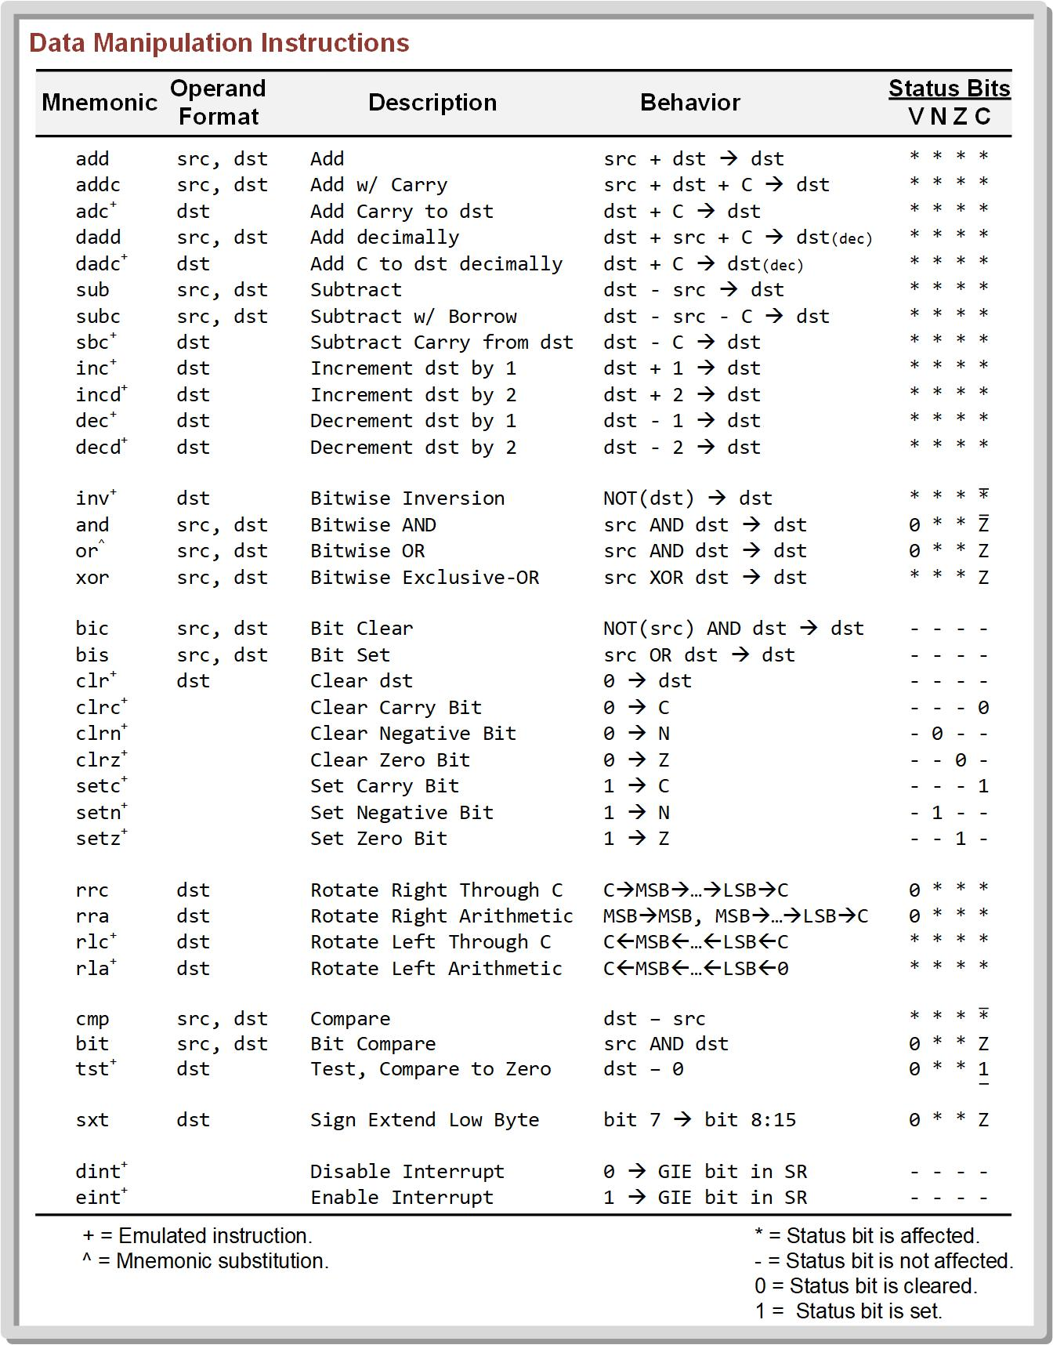
Ch. 7: Data Manipulation Instructions
7.1.1 Addition instructions
7.1 Arithmetic Instructions

Slide 7
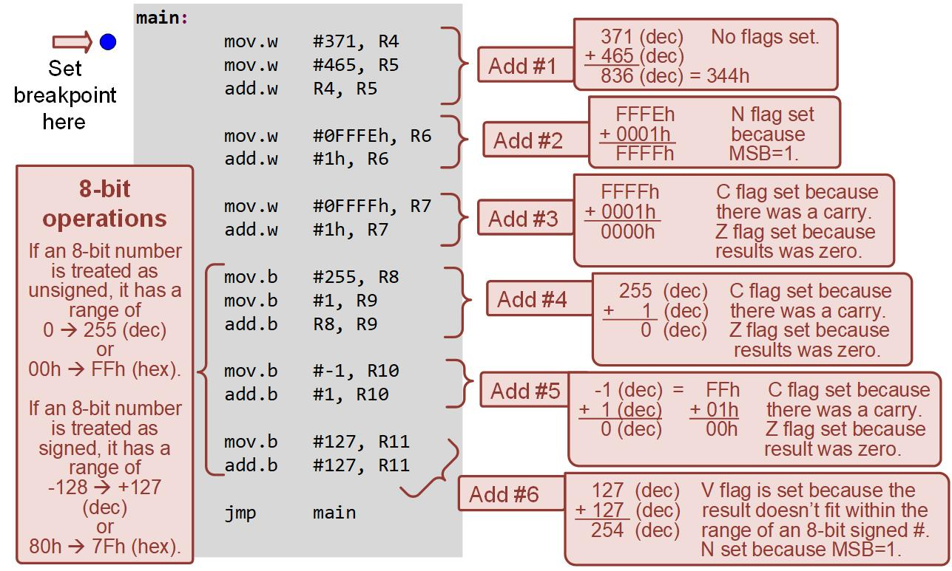
Ch. 7: Data Manipulation Instructions
Example: Using the ADD instruction
Image Courtesy of
Recording Connection of Canada
7.1 Arithmetic Instructions

Slide 8
Ch. 7: Data Manipulation Instructions
Example: Using the Addition instruction
Step 1: Create a new Empty Assembly-only CCS project titled:
Asm_ALU_ADD
Step 2: Type in the following code into the main.asm file where the comments say “Main loop here.”
Image Courtesy of https://neodem.wp.horizon.ac.uk/
Image Courtesy of
Recording Connection of Canada
7.1 Arithmetic Instructions

Slide 9
Ch. 7: Data Manipulation Instructions
Example: Using the Addition instruction
Step 3: Debug your program and correct any errors.
Step 4: Set a breakpoint before the first instruction
mov.w #371, R4
Step 5: Open the register viewer and expand the Core Registers item to see the CPU registers. Also expand the status register.
Image Courtesy of https://neodem.wp.horizon.ac.uk/
Image Courtesy of
Recording Connection of Canada
Image Courtesy of
Recording Connection of Canada
7.1 Arithmetic Instructions

Slide 10

Ch. 7: Data Manipulation Instructions
Example: Using the Addition instruction
Step 6: Run your program to the breakpoint.
Step 7: Step your program to observe the operation of each addition.
Image Courtesy of https://neodem.wp.horizon.ac.uk/
Image Courtesy of
Recording Connection of Canada
Image Courtesy of
Recording Connection of Canada
7.1 Arithmetic Instructions

Slide 11

Embedded Systems Design
Chapter 7: Data Manipulation Instructions
7.1 Arithmetic Instructions (ADD)
www.youtube.com/c/DigitalLogicProgramming_LaMeres
Brock J. LaMeres, Ph.D.

Slide 12
Embedded Systems Design
Chapter 7: Data Manipulation Instructions
7.1 Arithmetic Instructions (ADDC = Add with Carry)
Brock J. LaMeres, Ph.D.

Slide 13
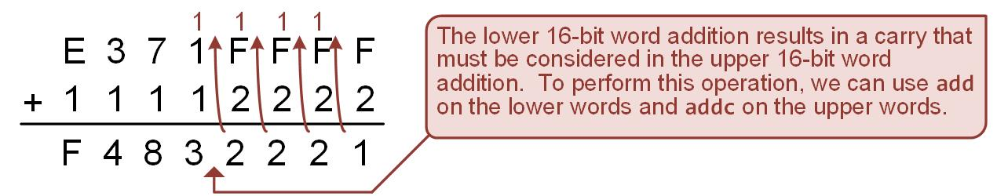
Ch. 7: Data Manipulation Instructions
7.1.1 Addition with Carry instruction
One of the limitations of the add instruction is that it only operates on 16-bit words.
For numbers larger than 16-bit words, we add the lower 16-bit words of the input number first using add, then include the carry that was potentially generated in the addition of the next upper 16-bit words of the inputs.
The addition of higher order words that include the carry from prior additions is repeated until all of the bits in the inputs have been added.
The addc instruction gives us the functionality to include the carry in the addition. src + dst + C → dst
7.1 Arithmetic Instructions

Slide 14
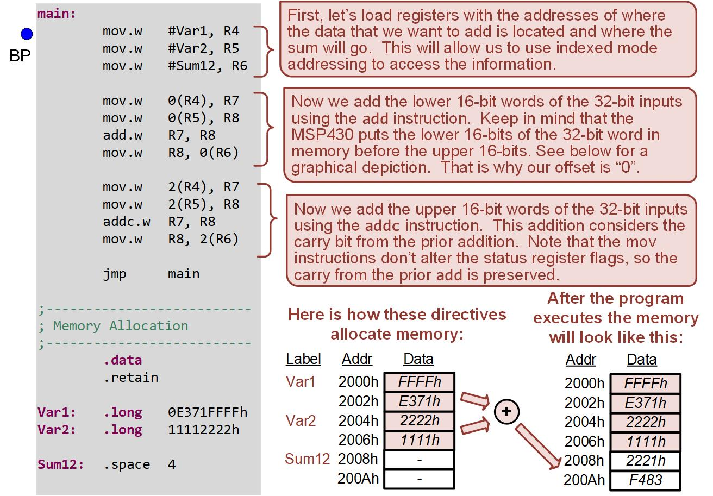
Ch. 7: Data Manipulation Instructions
Example: Using the Addition with Carry instruction
7.1 Arithmetic Instructions

Slide 15
Ch. 7: Data Manipulation Instructions
Example: Using the Addition with Carry instruction
Step 1: Create a new Empty Assembly-only CCS project titled:
Asm_ALU_ADDC
Step 2: Type in the following code into the main.asm file where the comments say “Main loop here.”
Image Courtesy of https://neodem.wp.horizon.ac.uk/
7.1 Arithmetic Instructions

Slide 16
Ch. 7: Data Manipulation Instructions
Example: Using the Addition with Carry instruction
Step 3: Debug your program and correct any errors.
Step 4: Set a breakpoint before the first instruction
mov.w #Var1, R4
Step 5: Open the register viewer and expand the Core Register item to see the CPU registers. Also expand the status register. Also go to address 0x2000 in the Memory Browser.
Image Courtesy of https://neodem.wp.horizon.ac.uk/
7.1 Arithmetic Instructions

Slide 17
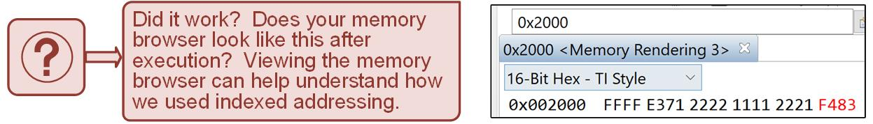
Ch. 7: Data Manipulation Instructions
Example: Using the Addition with Carry instruction
Step 6: Run your program to the breakpoint.
Step 7: Step your program to observe its operation.
Image Courtesy of https://neodem.wp.horizon.ac.uk/
Image Courtesy of
Recording Connection of Canada
Image Courtesy of
Recording Connection of Canada
7.1 Arithmetic Instructions

Slide 18

Embedded Systems Design
Chapter 7: Data Manipulation Instructions
7.1 Arithmetic Instructions (ADDC = Add with Carry)
www.youtube.com/c/DigitalLogicProgramming_LaMeres
Brock J. LaMeres, Ph.D.

Slide 19
Embedded Systems Design
Chapter 7: Data Manipulation Instructions
7.1 Arithmetic Instructions (SUB)
Brock J. LaMeres, Ph.D.

Slide 20
Ch. 7: Data Manipulation Instructions
7.1.2 Subtraction instructions
sub – performs binary addition on two operands and puts the difference back into the dst. dst – src → dst
The operation can be performed on both 8-bit and 16-bit words by appending .w or .b .
The four status flags can be updated.
This operation works the same regardless of whether the src and dst are treated as unsigned or signed numbers.
Image Courtesy of https://neodem.wp.horizon.ac.uk/
Image Courtesy of
Recording Connection of Canada
7.1 Arithmetic Instructions

Slide 21
Ch. 7: Data Manipulation Instructions
7.1.2 Subtraction instructions
The MSP430 does not actually contain a subtraction circuit, instead it converts the src into its negative equivalent by performing two’s compliment on it, and then it adds the src to the dst. A – B = A + (-B)
This explains how the carry flag can be asserted.
When C = 1, then no borrow was required.
When C = 0, then a borrow was required.
Image Courtesy of https://neodem.wp.horizon.ac.uk/
Image Courtesy of
Recording Connection of Canada
7.1 Arithmetic Instructions

Slide 22
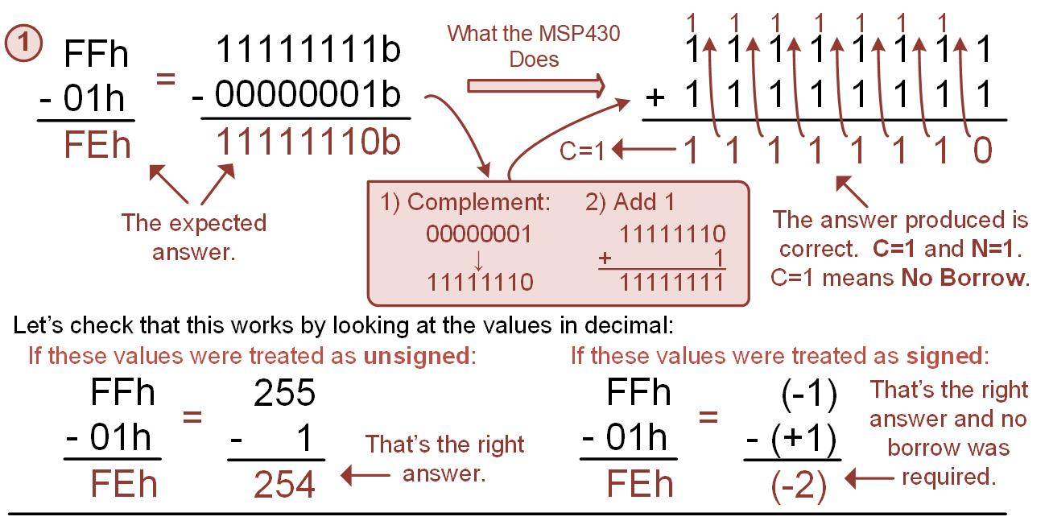
Ch. 7: Data Manipulation Instructions
How the Subtraction instruction Works (Ex 1 w/ No Borrow)
7.1 Arithmetic Instructions

Slide 23
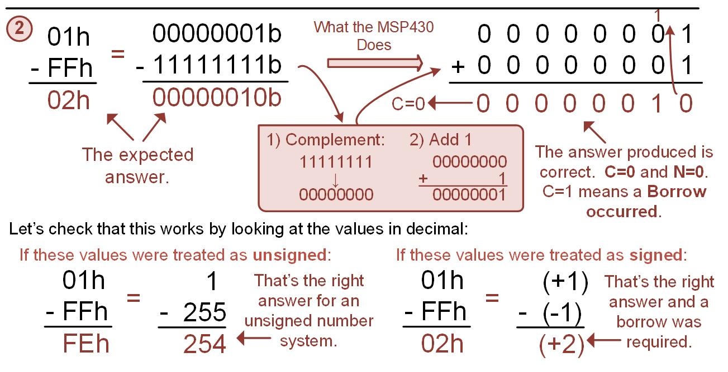
Ch. 7: Data Manipulation Instructions
How the Subtraction instruction Works (Ex 2 w/ Borrow)
7.1 Arithmetic Instructions

Slide 24
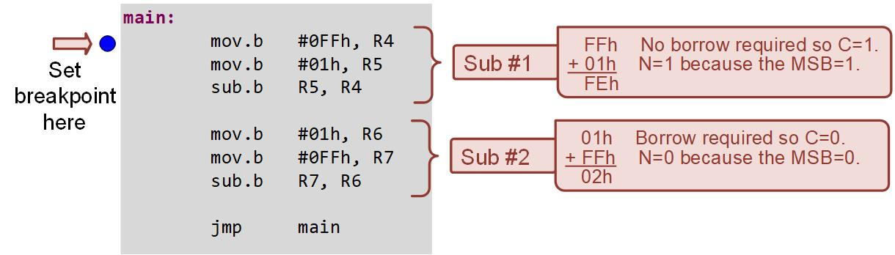
Ch. 7: Data Manipulation Instructions
Example: Using the Subtraction Instruction
7.1 Arithmetic Instructions

Slide 25
Ch. 7: Data Manipulation Instructions
Example: Using the Subtraction Instruction
Step 1: Create a new Empty Assembly-only CCS project titled:
Asm_ALU_SUB
Step 2: Type in the following code into the main.asm file where the comments say “Main loop here.”
7.1 Arithmetic Instructions

Slide 26

Ch. 7: Data Manipulation Instructions
Example: Using the Subtraction Instruction
Step 3: Debug your program and correct any errors.
Step 4: Set a breakpoint before the first instruction
mov.b #0FFh, R4
Step 5: Open the register viewer and expand the Core Registers item to see the CPU registers. Also expand the status register.
Step 6: Run your program to the breakpoint.
Step 7: Step your program to observe its operation.
7.1 Arithmetic Instructions

Slide 27
Embedded Systems Design
Chapter 7: Data Manipulation Instructions
7.1 Arithmetic Instructions (SUB)
www.youtube.com/c/DigitalLogicProgramming_LaMeres
Brock J. LaMeres, Ph.D.

Slide 28
Embedded Systems Design
Chapter 7: Data Manipulation Instructions
7.1 Arithmetic Instructions (SUBC = Subtract w/ Carry)
Brock J. LaMeres, Ph.D.

Slide 29
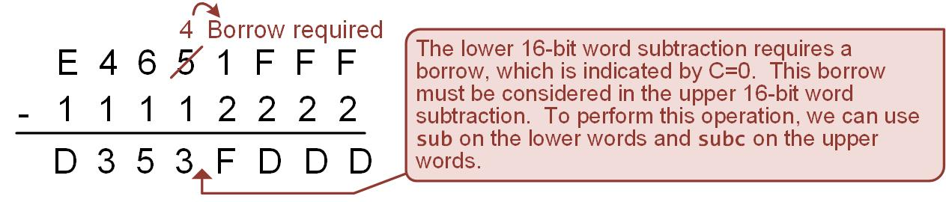
Ch. 7: Data Manipulation Instructions
7.1.2 Subtraction with Carry instruction
subc – used when subtracting numbers that are larger than 16-bit words. dst – src – not(C) → dst
The subtraction of higher order words that include the borrow from prior subtractions is repeated until all of the bits in the inputs have been subtracted.
Accomplished by subtracting the lower 16-bit words of the input numbers first using sub, and then including the borrow that was potentially generated in the subtraction of the next upper 16-bit words of the inputs.
C = 0 → borrow occurred; C = 1 → no borrow occurred
7.1 Arithmetic Instructions

Slide 30
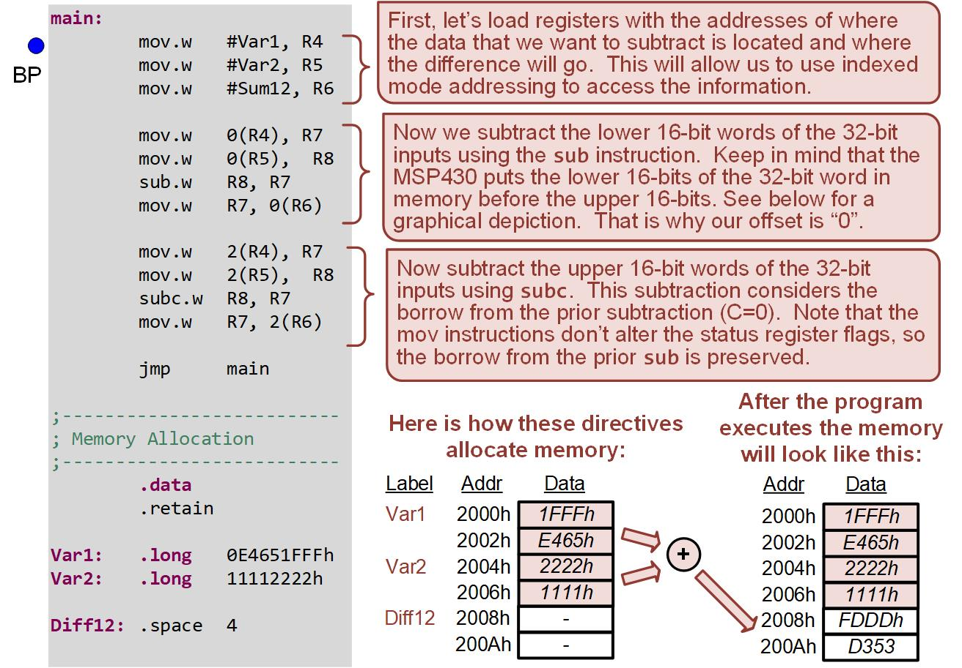
Ch. 7: Data Manipulation Instructions
Example: Using Subtraction with Carry Instruction
7.1 Arithmetic Instructions

Slide 31
Ch. 7: Data Manipulation Instructions
Example: Using Subtraction with Carry Instruction
Step 1: Create a new Empty Assembly-only CCS project titled:
Asm_ALU_SUBC
Step 2: Type in the following code into the main.asm file where the comments say “Main loop here.”
Image Courtesy of https://neodem.wp.horizon.ac.uk/
7.1 Arithmetic Instructions

Slide 32
Ch. 7: Data Manipulation Instructions
Example: Using the Subtraction Instruction
Step 3: Debug your program and correct any errors.
Step 4: Set a breakpoint before the first instruction
mov.w #Var1, R4
Step 5: Open the register viewer and expand the Core Registers item to see the CPU registers. Also expand the status register. Also go to the address 0x2000 in the Memory Browser.
Image Courtesy of https://neodem.wp.horizon.ac.uk/
Image Courtesy of
Recording Connection of Canada
7.1 Arithmetic Instructions

Slide 33
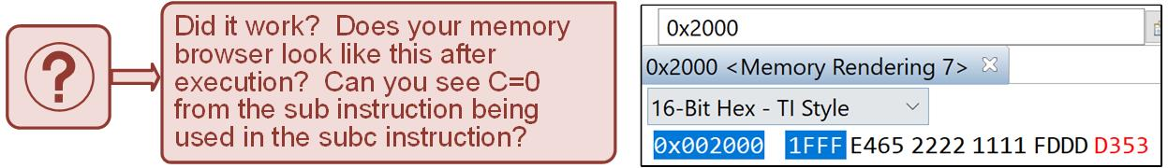
Ch. 7: Data Manipulation Instructions
Example: Using the Subtraction Instruction
Step 6: Run your program to the breakpoint.
Step 7: Step your program to observe its operation.
Image Courtesy of https://neodem.wp.horizon.ac.uk/
Image Courtesy of
Recording Connection of Canada
7.1 Arithmetic Instructions

Slide 34
Embedded Systems Design
Chapter 7: Data Manipulation Instructions
7.1 Arithmetic Instructions (SUBC = Subtract w/ Borrow)
www.youtube.com/c/DigitalLogicProgramming_LaMeres
Brock J. LaMeres, Ph.D.

Slide 35
Embedded Systems Design
Chapter 7: Data Manipulation Instructions
7.1 Arithmetic Instructions (Increments and Decrements)
Brock J. LaMeres, Ph.D.

Slide 36
Ch. 7: Data Manipulation Instructions
7.1.3 Increments and Decrements
inc & incd – incremented a storage location by 1 and 2 respectively.
dec & decd – decrements a storage location by 1 and 2 respectively.
Image Courtesy of https://neodem.wp.horizon.ac.uk/
Image Courtesy of
Recording Connection of Canada
Image Courtesy of
Recording Connection of Canada
7.1 Arithmetic Instructions

Slide 37
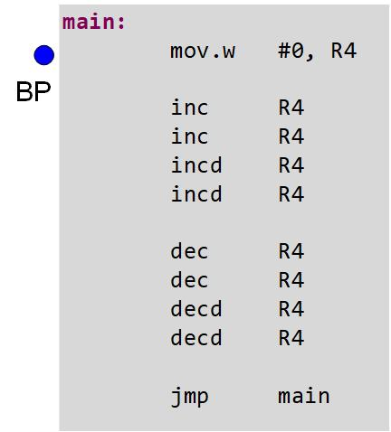
Ch. 7: Data Manipulation Instructions
7.1.3 Increments and Decrements
Step 1: Create a new Empty Assembly-only CCS project titled:
Asm_ALU_INC_DEC
Step 2: Type in the following code into the main.asm file where the comments say “Main loop here.”
7.1 Arithmetic Instructions

Slide 38
Ch. 7: Data Manipulation Instructions
7.1.3 Increments and Decrements
Step 3: Debug your program and correct any errors.
Step 4: Set a breakpoint before the first instruction
mov.w #0, R4
Step 5: Open the register viewer and expand the Core Registers item to see the CPU registers.
Image Courtesy of https://neodem.wp.horizon.ac.uk/
Image Courtesy of
Recording Connection of Canada
Image Courtesy of
Recording Connection of Canada
7.1 Arithmetic Instructions

Slide 39
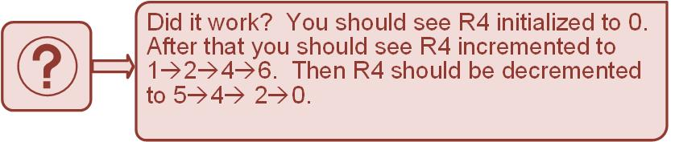
Ch. 7: Data Manipulation Instructions
7.1.3 Increments and Decrements
Step 6: Run your program to the breakpoint.
Step 7: Step your program to observe its operation.
Image Courtesy of https://neodem.wp.horizon.ac.uk/
Image Courtesy of
Recording Connection of Canada
Image Courtesy of
Recording Connection of Canada
7.1 Arithmetic Instructions

Slide 40
Ch. 7: Data Manipulation Instructions
7.1.3 Increments and Decrements
Step 8: Now enter the following code. You can place this after the prior inc/dec lines.
Step 9: Debug your program and correct any errors.
Step 10: Step your program to observe its operation.
Step 11: Open the register viewer and memory browsers at 0x2000.
Image Courtesy of https://neodem.wp.horizon.ac.uk/
Image Courtesy of
Recording Connection of Canada
Image Courtesy of
Recording Connection of Canada
7.1 Arithmetic Instructions

Slide 41
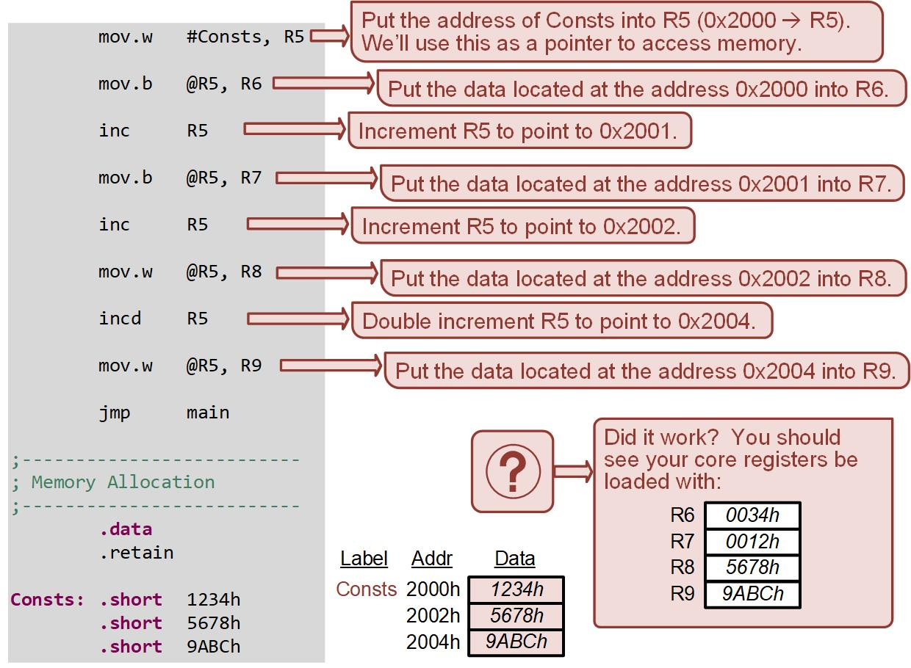
Ch. 7: Data Manipulation Instructions
7.1.3 Increments and Decrements
7.1 Arithmetic Instructions

Slide 42
Embedded Systems Design
Chapter 7: Data Manipulation Instructions
7.1 Arithmetic Instructions (Increments and Decrements)
www.youtube.com/c/DigitalLogicProgramming_LaMeres
Brock J. LaMeres, Ph.D.

Slide 43
Embedded Systems Design
Chapter 7: Data Manipulation Instructions
7.2 Logic Instructions
Brock J. LaMeres, Ph.D.

Slide 44
Ch. 7: Data Manipulation Instructions
7.2 Logic Instructions
inv – performs an inversion on each bit of the operand. !dst → dst
and – performs a logical and on the two operands and places the result back into the dst. src AND dst → dst
or – performs a logical or on the two operands and places the result back into the dst. src OR dst → dst
xor – performs an exclusive-or operation on the src and dst and places the result back into the dst. src XOR dst → dst
Image Courtesy of https://neodem.wp.horizon.ac.uk/
7.2 Logic Instructions

Slide 45
Ch. 7: Data Manipulation Instructions
7.2 Logic Instructions
Bitwise operation – takes place on the individual bits of the src and dst independent of each other.
Bit masking – the of setting, clearing, toggling, or testing the value of a bit within a word.
Image Courtesy of https://neodem.wp.horizon.ac.uk/
7.2 Logic Instructions

Slide 46
Ch. 7: Data Manipulation Instructions
7.2 Logic Instructions
Bit Masking w/ AND
Image Courtesy of https://neodem.wp.horizon.ac.uk/
Image Courtesy of
Recording Connection of Canada
Image Courtesy of
Recording Connection of Canada
Image Courtesy of
Recording Connection of Canada
7.2 Logic Instructions

Slide 47
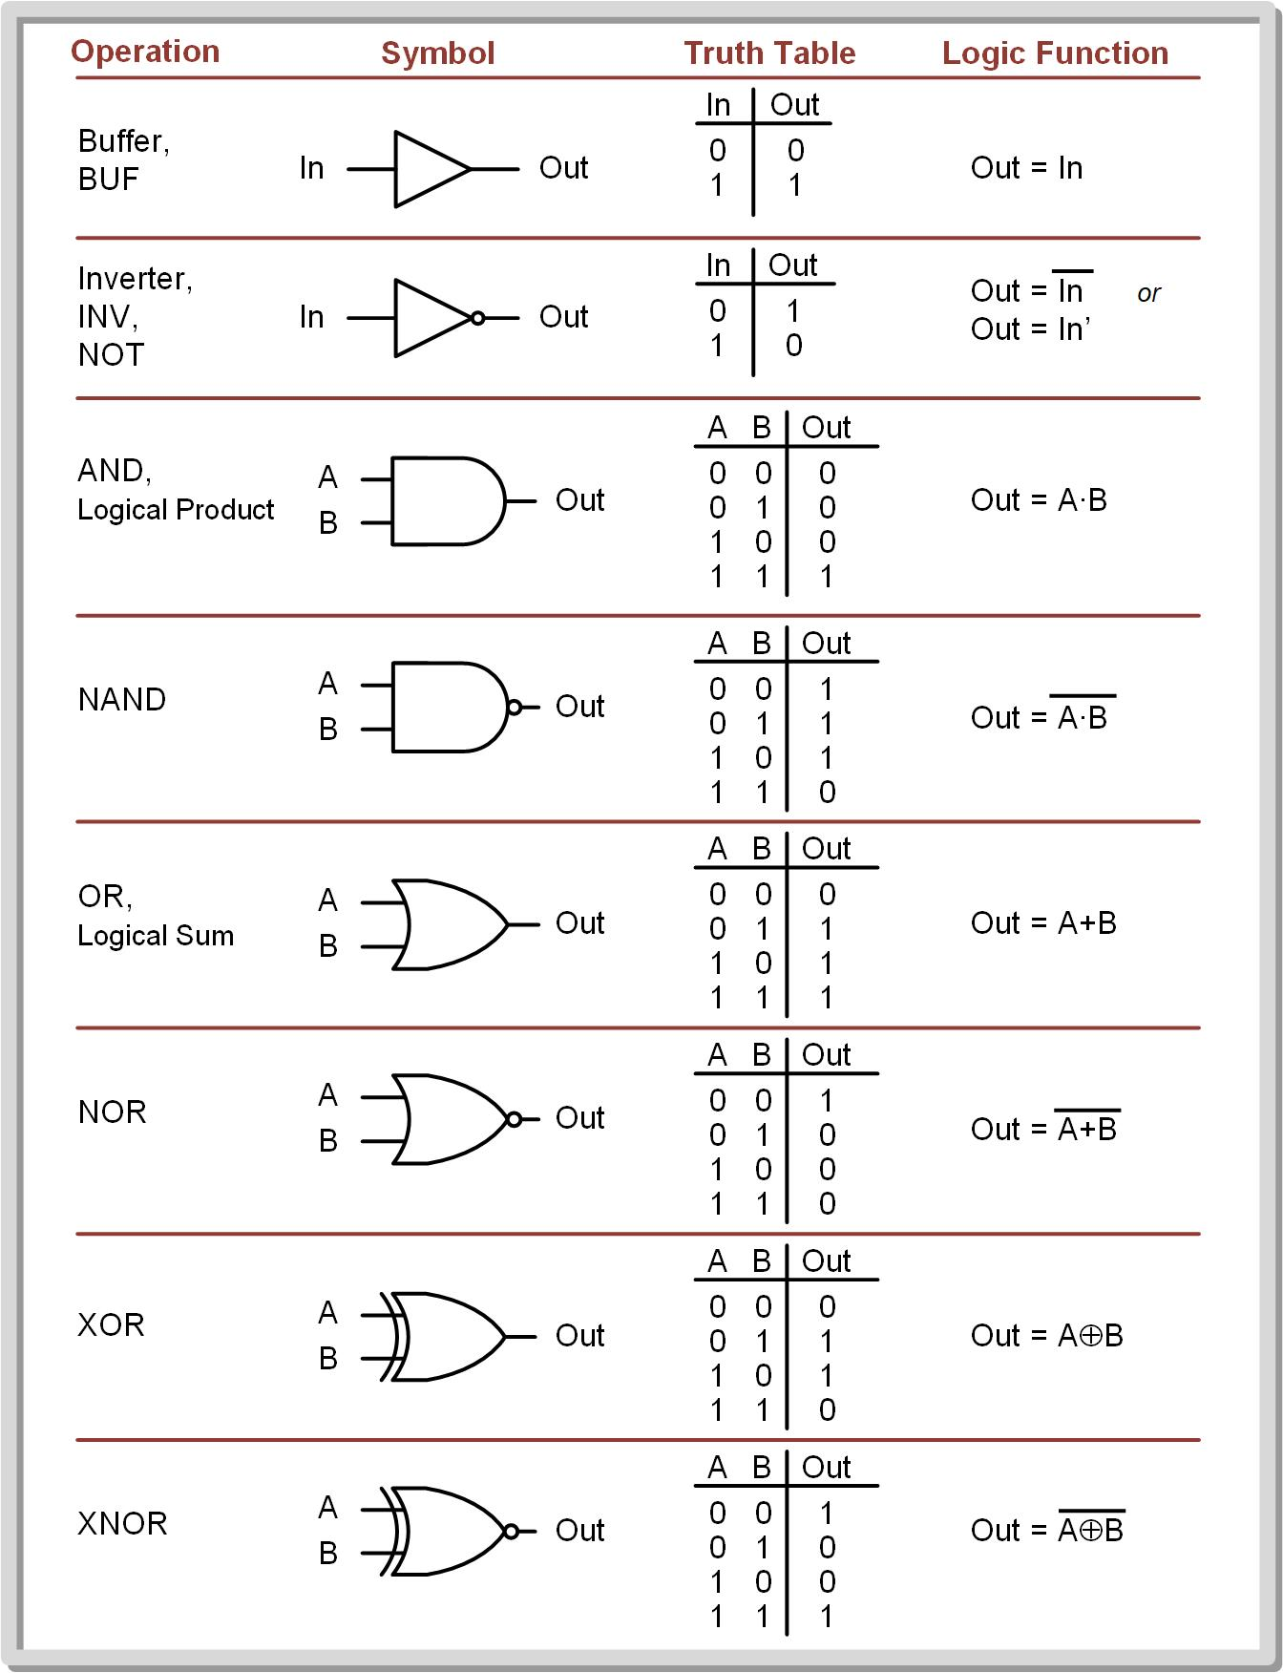
Ch. 7: Data Manipulation Instructions
7.2 Logic Instructions
Bit Masking w/ AND
Image Courtesy of https://neodem.wp.horizon.ac.uk/
Image Courtesy of
Recording Connection of Canada
Image Courtesy of
Recording Connection of Canada
Image Courtesy of
Recording Connection of Canada
7.2 Logic Instructions

Slide 48
Ch. 7: Data Manipulation Instructions
7.2 Logic Instructions
Clear
AND’ing anything with a 0 results in a 0.
Bit Masking w/ AND
Image Courtesy of https://neodem.wp.horizon.ac.uk/
7.2 Logic Instructions

Slide 49
Ch. 7: Data Manipulation Instructions
7.2 Logic Instructions
Clear
AND’ing anything with a 0 results in a 0.
AND’ing anything with a 1 has no impact.
Bit Masking w/ AND
Image Courtesy of https://neodem.wp.horizon.ac.uk/
7.2 Logic Instructions

Slide 50
Ch. 7: Data Manipulation Instructions
7.2 Logic Instructions
A “mask” is a set of bits that indicate which bits within a dst are going to be altered depending on the 1s and 0s in the mask.
When using a mask with an AND operation, any position within the mask that contains a 0 will result in the corresponding bit in the dst being cleared.
When using a mask with an AND operation, any position within the mask that contains a 1 will simply leave the original value within the dst.
Example Mask: 00111111
Image Courtesy of https://neodem.wp.horizon.ac.uk/
Image Courtesy of
Recording Connection of Canada
Image Courtesy of
Recording Connection of Canada
Image Courtesy of
Recording Connection of Canada
7.2 Logic Instructions

Slide 51
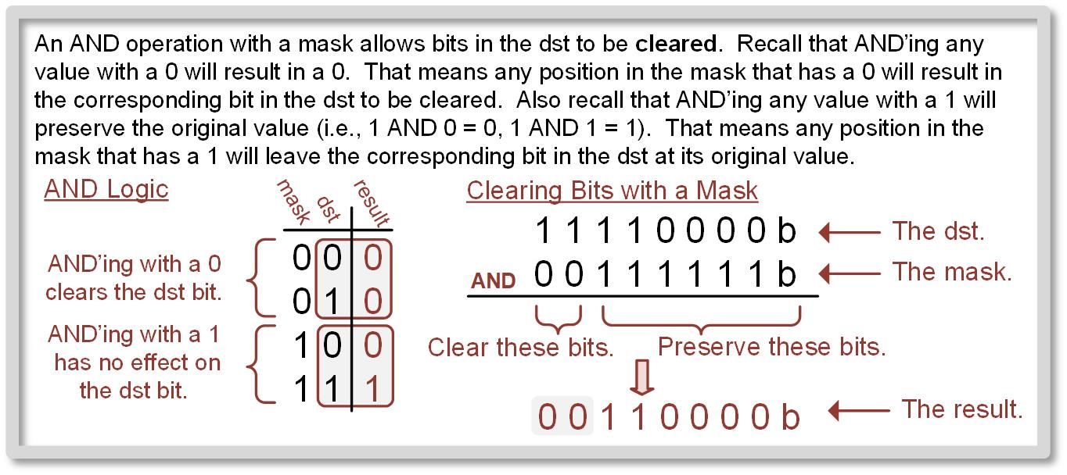
Ch. 7: Data Manipulation Instructions
7.2 Logic Instructions
Using a mask and an AND operation to clear bits.
7.2 Logic Instructions

Slide 52
Ch. 7: Data Manipulation Instructions
7.2 Logic Instructions
An AND operation with a mask can also check the value of a particular bit(s).
This can be accomplished by using a mask with a 1 in the position of interest and 0’s everywhere else.
The 0’s will be clear all bits except the position of interest.
If the position of interest is a 0, then the entire dst word will be a zero and the Z flag will be asserted (Z = 1).
If the position of interest is a 1, then the entire dst word will NOT be a zero, and the Z flag will not be asserted (Z = 0).
Image Courtesy of https://neodem.wp.horizon.ac.uk/
Image Courtesy of
Recording Connection of Canada
Image Courtesy of
Recording Connection of Canada
Image Courtesy of
Recording Connection of Canada
7.2 Logic Instructions

Slide 53
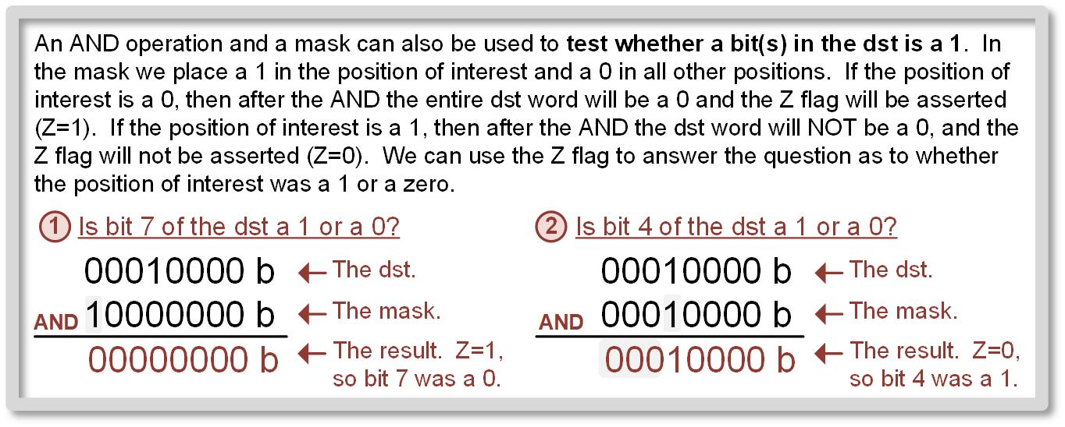
Ch. 7: Data Manipulation Instructions
7.2 Logic Instructions
Using a mask and an AND operation to test bits.
7.2 Logic Instructions

Slide 54
Ch. 7: Data Manipulation Instructions
7.2 Logic Instructions
Bit Masking w/ OR
Image Courtesy of https://neodem.wp.horizon.ac.uk/
7.2 Logic Instructions

Slide 55
Ch. 7: Data Manipulation Instructions
7.2 Logic Instructions
Set
OR’ing anything with a 1 will result in a 1.
Bit Masking w/ OR
Image Courtesy of https://neodem.wp.horizon.ac.uk/
7.2 Logic Instructions

Slide 56
Ch. 7: Data Manipulation Instructions
7.2 Logic Instructions
Set
OR’ing anything with a 0 has no impact.
OR’ing anything with a 1 will result in a 1.
Bit Masking w/ OR
Image Courtesy of https://neodem.wp.horizon.ac.uk/
7.2 Logic Instructions

Slide 57
Ch. 7: Data Manipulation Instructions
7.2 Logic Instructions
A logical OR will produce a 1 when either of the bits of the inputs are a 1. Thus, we can use the OR operation with a one to set any bit within a word.
When using a mask with an OR, the mask indicates which bit(s) to set and which to preserve.
Any position within the mask that contains a 1 will result in the corresponding bit int eh dst being set.
Any position within the mask that contains a 0 will simply leave the original value within the dst.
Example Mask: 00011111
Image Courtesy of https://neodem.wp.horizon.ac.uk/
Image Courtesy of
Recording Connection of Canada
Image Courtesy of
Recording Connection of Canada
Image Courtesy of
Recording Connection of Canada
7.2 Logic Instructions

Slide 58
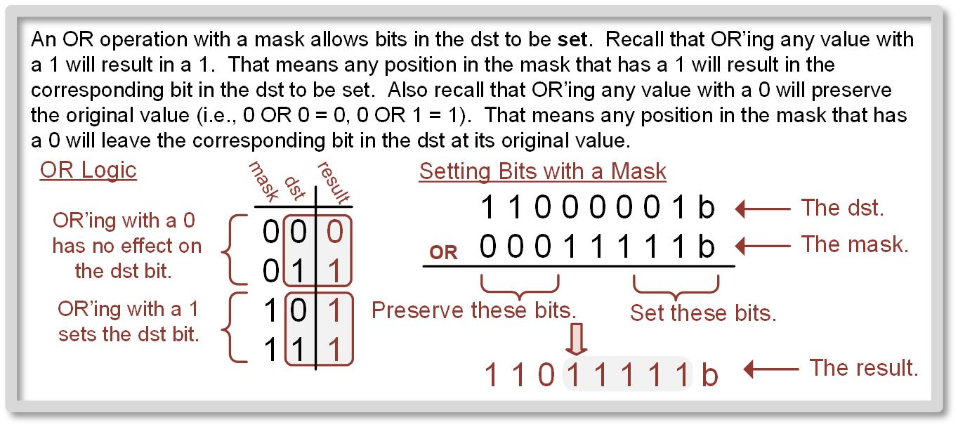
Ch. 7: Data Manipulation Instructions
7.2 Logic Instructions
Using a mask and an OR operation to set bits.
7.2 Logic Instructions

Slide 59
Ch. 7: Data Manipulation Instructions
7.2 Logic Instructions
Bit Masking w/ XOR
Image Courtesy of https://neodem.wp.horizon.ac.uk/
7.2 Logic Instructions

Slide 60
Ch. 7: Data Manipulation Instructions
7.2 Logic Instructions
Toggle
XOR’ing anything with a 1 will complement the original value.
Bit Masking w/ XOR
Image Courtesy of https://neodem.wp.horizon.ac.uk/
7.2 Logic Instructions

Slide 61
Ch. 7: Data Manipulation Instructions
7.2 Logic Instructions
Toggle
XOR’ing anything with a 0 has no impact.
XOR’ing anything with a 1 will complement the original value.
Bit Masking w/ XOR
Image Courtesy of https://neodem.wp.horizon.ac.uk/
7.2 Logic Instructions

Slide 62
Ch. 7: Data Manipulation Instructions
7.2 Logic Instructions
The XOR instruction can be used to toggle bits within the dst.
When XOR’ing a dst bit with a zero, the dst bit will remain unchanged.
To toggle bit(s) in the dst, we simply XOR it with a mask where any bits to be toggled contain a one and all other bits to be preserved are zeros.
Example Mask: 11110000
Image Courtesy of https://neodem.wp.horizon.ac.uk/
Image Courtesy of
Recording Connection of Canada
Image Courtesy of
Recording Connection of Canada
Image Courtesy of
Recording Connection of Canada
7.2 Logic Instructions

Slide 63
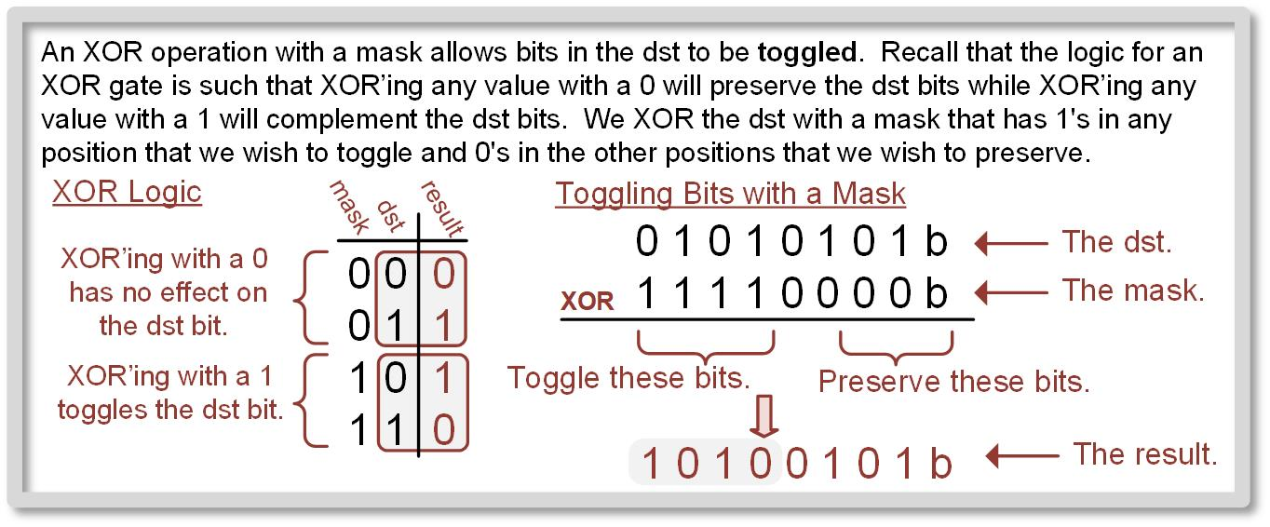
Ch. 7: Data Manipulation Instructions
7.2 Logic Instructions
Using a mask and an XOR operation to toggle bits.
7.2 Logic Instructions

Slide 64
Ch. 7: Data Manipulation Instructions
Example: Logic Instructions to Manipulate Bits
Step 1: Create a new Empty Assembly-only project titled:
Asm_ALU_Logic
Step 2: Type in the following code into the main.asm file where the comments say “Main loop here.”
Image Courtesy of
Recording Connection of Canada
Image Courtesy of https://neodem.wp.horizon.ac.uk/
Image Courtesy of
Recording Connection of Canada
Image Courtesy of
Recording Connection of Canada
7.2 Logic Instructions

Slide 65
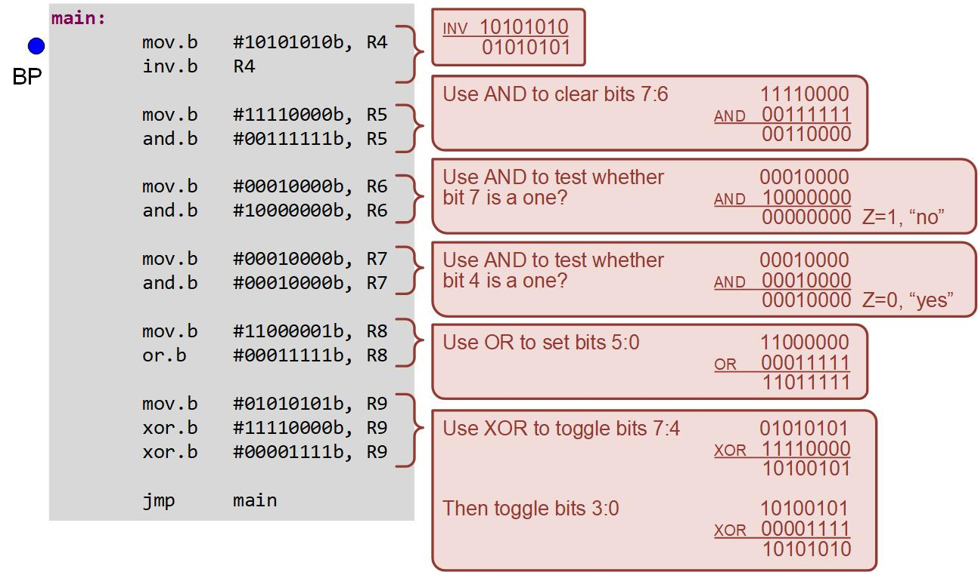
Ch. 7: Data Manipulation Instructions
Example: Logic Instructions to Manipulate Bits
7.2 Logic Instructions

Slide 66
Ch. 7: Data Manipulation Instructions
Example: Logic Instructions to Manipulate Bits
Step 3: Debug your program and correct any errors.
Step 4: Set a breakpoint before the first instruction
mov.b #10101010, R4
Step 5: Open the register viewer and expand the Core Registers item to see the CPU registers. Also expand SR so you can see the Z flag. Change the number format of R4 → R9 to binary.
Image Courtesy of https://neodem.wp.horizon.ac.uk/
Image Courtesy of
Recording Connection of Canada
Image Courtesy of
Recording Connection of Canada
Image Courtesy of
Recording Connection of Canada
7.2 Logic Instructions

Slide 67

Ch. 7: Data Manipulation Instructions
Example: Logic Instructions to Manipulate Bits
Step 6: Run your program to the breakpoint.
Step 7: Step your program to observe its operation.
Image Courtesy of https://neodem.wp.horizon.ac.uk/
Image Courtesy of
Recording Connection of Canada
Image Courtesy of
Recording Connection of Canada
Image Courtesy of
Recording Connection of Canada
7.2 Logic Instructions

Slide 68
Embedded Systems Design
Chapter 7: Data Manipulation Instructions
7.2 Logic Instructions
www.youtube.com/c/DigitalLogicProgramming_LaMeres
Brock J. LaMeres, Ph.D.

Slide 69
Embedded Systems Design
Chapter 7: Data Manipulation Instructions
7.3 Bit Set and Bit Clear Instructions
Brock J. LaMeres, Ph.D.

Slide 70
Ch. 7: Data Manipulation Instructions
7.3 Bit Set and Bit Clear Instructions
bis (bit set) – sets the bits in the dst corresponding to 1’s within the src operand mask.
bic (bit clear) – clears the bits in the dst corresponding to 1’s within the src operand mask.
The bis and bic instructions work on both 16-bit words (.w) and 8-bit bytes (.b).
All bits within the mask for each instruction that are 0’s will leave the dst bits unaltered.
By providing a masking approach that works the same for bis and bic, the same masks can be used throughout the program to alter the same bit location.
Immediate mode is most common.
Image Courtesy of
Recording Connection of Canada
Image Courtesy of
Recording Connection of Canada
Image Courtesy of
Recording Connection of Canada
Image Courtesy of
Recording Connection of Canada
Image Courtesy of https://neodem.wp.horizon.ac.uk/
7.3 Bit Set and Bit Clear Instructions

Slide 71
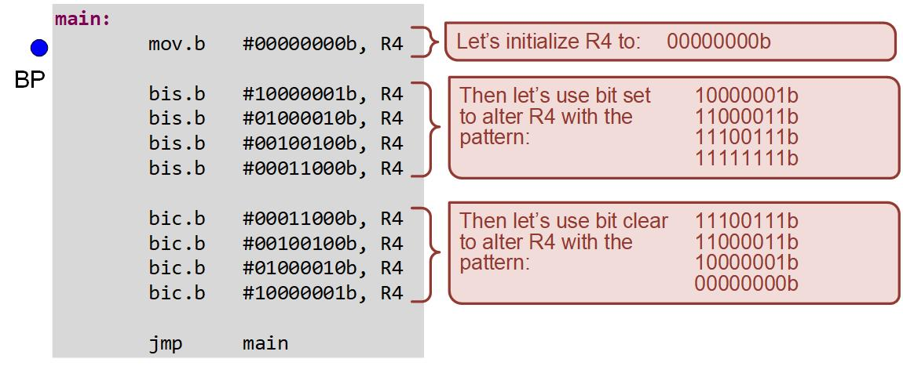
Ch. 7: Data Manipulation Instructions
Example: Using BIS and BIC to Set & Clear Bits
Step 1: Create a new Empty Assembly-only project titled:
Asm_ALU_BIS_BIC
Step 2: Type in the following code into the main.asm file where the comments say “Main loop here.”
7.3 Bit Set and Bit Clear Instructions

Slide 72

Ch. 7: Data Manipulation Instructions
Example: Using BIS and BIC to Set & Clear Bits
Step 3: Debug your program and correct any errors.
Step 4: Set a breakpoint before the first instruction
mov.b #00000000b, R4
Step 5: Open the register viewer and expand the Core Registers item to see the CPU registers. Change the number format of R4 to binary.
Step 6: Run your program to the breakpoint.
Step 7: Step your program to observe its operation.
7.3 Bit Set and Bit Clear Instructions

Slide 73
Embedded Systems Design
Chapter 7: Data Manipulation Instructions
7.3 Bit Set and Bit Clear Instructions
www.youtube.com/c/DigitalLogicProgramming_LaMeres
Brock J. LaMeres, Ph.D.

Slide 74
Embedded Systems Design
Chapter 7: Data Manipulation Instructions
7.4 Test Instructions
Brock J. LaMeres, Ph.D.

Slide 75
Ch. 7: Data Manipulation Instructions
7.4 Test Instructions
Testing a bit or word – try to determine whether a bit is one, whether the value is zero, whether the values is negative, or whether the value is the same as another number.
Image Courtesy of
Recording Connection of Canada
Image Courtesy of
Recording Connection of Canada
Image Courtesy of
Recording Connection of Canada
Image Courtesy of
Recording Connection of Canada
Image Courtesy of
Recording Connection of Canada
Image Courtesy of https://neodem.wp.horizon.ac.uk/
7.4 Test Instructions

Slide 76
Ch. 7: Data Manipulation Instructions
7.4 Test Instructions
Bit (bit test) – perform a logical AND with the mask provided in the src and the value held in the dst.
This is used to determine whether certain bits within the dst are 1’s by checking the Z flag after the operation.
If the bit location in the dst dictated by the mask is a 1, then the result of the AND will be value that is not zero and the Z flag will not be asserted (Z = 0).
If the Z flag is asserted (Z = 1), then the bit value of interest in the dst was a zero.
Image Courtesy of
Recording Connection of Canada
Image Courtesy of
Recording Connection of Canada
Image Courtesy of
Recording Connection of Canada
Image Courtesy of
Recording Connection of Canada
Image Courtesy of
Recording Connection of Canada
Image Courtesy of https://neodem.wp.horizon.ac.uk/
7.4 Test Instructions

Slide 77
Ch. 7: Data Manipulation Instructions
7.4 Test Instructions
Cmp (compare) – subtracts the src from the dst and updates the status flags, but leaves the dst intact.
This is used to determine if the dst is equal to a specific value by checking the Z flag after the operation.
If the src and dst are equal, the result of the subtraction will result in zero, and the Z flag will be asserted (Z = 1).
If the Z flag is not asserted (Z = 0), then src and dst were not the same.
Image Courtesy of
Recording Connection of Canada
Image Courtesy of
Recording Connection of Canada
Image Courtesy of
Recording Connection of Canada
Image Courtesy of
Recording Connection of Canada
Image Courtesy of
Recording Connection of Canada
Image Courtesy of https://neodem.wp.horizon.ac.uk/
7.4 Test Instructions

Slide 78
Ch. 7: Data Manipulation Instructions
7.4 Test Instructions
Tst (test)– subtracts zero form the dst and updates the status flags.
This instruction allows us to determine whether the value in the dst is zero (Z = 1) or negative (N = 1).
Image Courtesy of
Recording Connection of Canada
Image Courtesy of
Recording Connection of Canada
Image Courtesy of
Recording Connection of Canada
Image Courtesy of
Recording Connection of Canada
Image Courtesy of
Recording Connection of Canada
Image Courtesy of https://neodem.wp.horizon.ac.uk/
7.4 Test Instructions

Slide 79
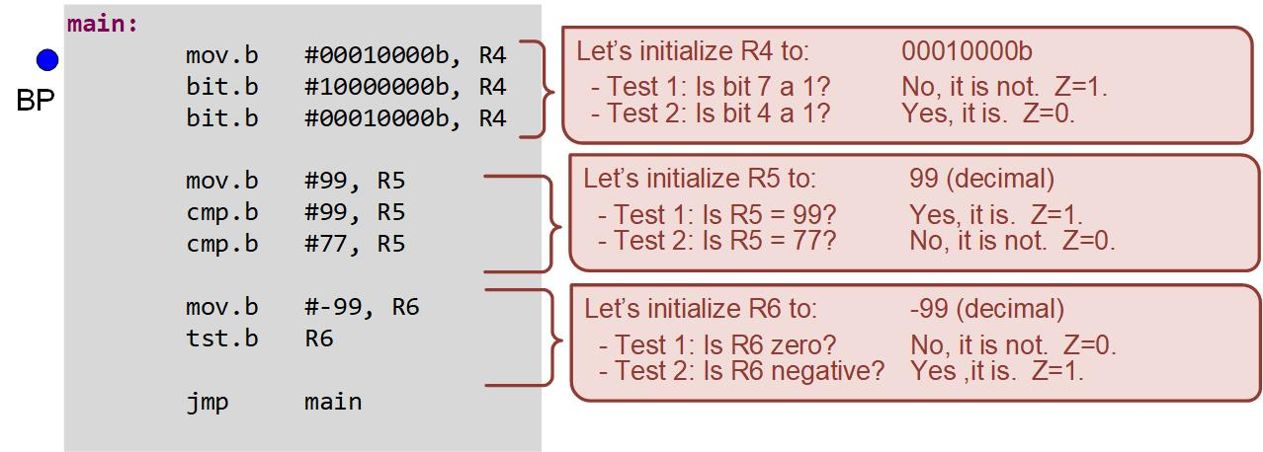
Ch. 7: Data Manipulation Instructions
7.4 Test Instructions
Step 1: Create a new Empty Assembly-only project titled:
Asm_ALU_TESTS
Step 2: Type in the following code into the main.asm file where the comments say “Main loop here.”
Image Courtesy of
Recording Connection of Canada
Image Courtesy of
Recording Connection of Canada
Image Courtesy of
Recording Connection of Canada
Image Courtesy of
Recording Connection of Canada
Image Courtesy of
Recording Connection of Canada
Image Courtesy of https://neodem.wp.horizon.ac.uk/
7.4 Test Instructions

Slide 80
Ch. 7: Data Manipulation Instructions
7.4 Test Instructions
Step 3: Debug your program and correct any errors.
Step 4: Set a breakpoint before the first instruction
mov.b #00010000b, R4
Step 5: Open the register viewer and expand the Core Registers item to see the CPU registers. Change the number format of R4 to binary and R5/R6 to decimal.
Image Courtesy of
Recording Connection of Canada
Image Courtesy of
Recording Connection of Canada
Image Courtesy of
Recording Connection of Canada
Image Courtesy of
Recording Connection of Canada
Image Courtesy of
Recording Connection of Canada
Image Courtesy of https://neodem.wp.horizon.ac.uk/
7.4 Test Instructions

Slide 81
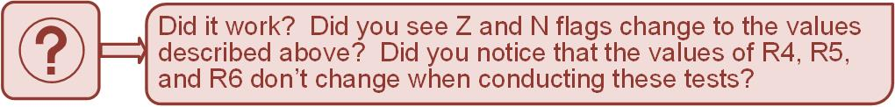
Ch. 7: Data Manipulation Instructions
7.4 Test Instructions
Step 6: Run your program to the breakpoint.
Step 7: Step your program to observe its operation.
Image Courtesy of
Recording Connection of Canada
Image Courtesy of
Recording Connection of Canada
Image Courtesy of
Recording Connection of Canada
Image Courtesy of
Recording Connection of Canada
Image Courtesy of
Recording Connection of Canada
Image Courtesy of
Recording Connection of Canada
Image Courtesy of
Recording Connection of Canada
Image Courtesy of
Recording Connection of Canada
Image Courtesy of
Recording Connection of Canada
Image Courtesy of
Recording Connection of Canada
Image Courtesy of https://neodem.wp.horizon.ac.uk/
7.4 Test Instructions

Slide 82
Embedded Systems Design
Chapter 7: Data Manipulation Instructions
7.4 Test Instructions
www.youtube.com/c/DigitalLogicProgramming_LaMeres
Brock J. LaMeres, Ph.D.

Slide 83
Embedded Systems Design
Chapter 7: Data Manipulation Instructions
7.5 Rotate Operations
Brock J. LaMeres, Ph.D.

Slide 84
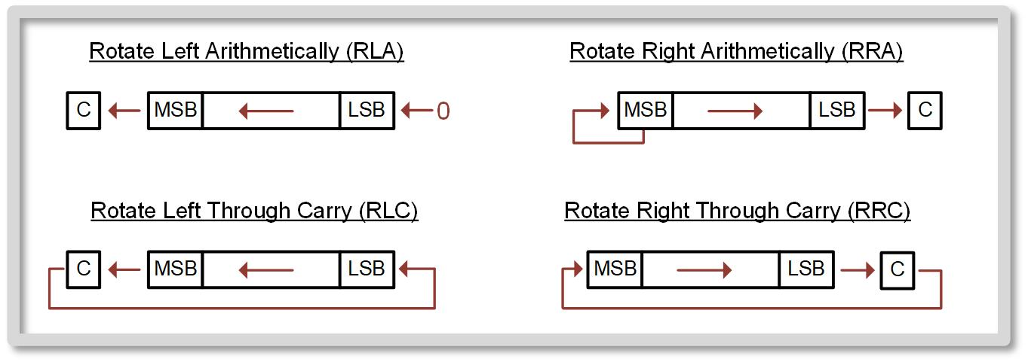
Ch. 7: Data Manipulation Instructions
7.5 Rotate Operations
Rotate instructions - used to shift in serial data into a parallel word, to sign extend negative numbers, or to perform multiply/divide by two operations.
7.5 Rotate Operations

Slide 85
Ch. 7: Data Manipulation Instructions
Example: Using Rotate Arithmetically
Step 1: Create a new Empty Assembly-only project titled:
Asm_ALU_ROTATE_ARITH
Step 2: Type in the following code into the main.asm file where the comments say “Main loop here.”
Image Courtesy of
Recording Connection of Canada
Image Courtesy of
Recording Connection of Canada
Image Courtesy of
Recording Connection of Canada
Image Courtesy of
Recording Connection of Canada
Image Courtesy of
Recording Connection of Canada
Image Courtesy of
Recording Connection of Canada
Image Courtesy of
Recording Connection of Canada
Image Courtesy of
Recording Connection of Canada
Image Courtesy of
Recording Connection of Canada
Image Courtesy of
Recording Connection of Canada
Image Courtesy of https://neodem.wp.horizon.ac.uk/
Image Courtesy of https://neodem.wp.horizon.ac.uk/
7.5 Rotate Operations

Slide 86
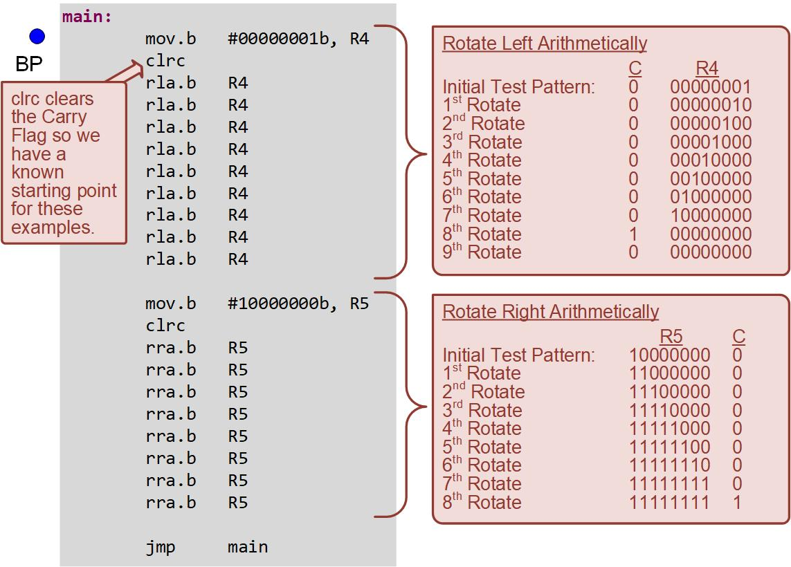
Ch. 7: Data Manipulation Instructions
Example: Using Rotate Arithmetically
7.5 Rotate Operations

Slide 87
Ch. 7: Data Manipulation Instructions
Example: Using Rotate Arithmetically
Step 3: Debug your program and correct any errors.
Step 4: Set a breakpoint before the first instruction
mov.b #00000001b, R4
Step 5: Open the register viewer and expand the Core Registers item to see the CPU registers. Change the number format of R4 → R5 to binary. Expand SR so you can see the C-flag.
Image Courtesy of
Recording Connection of Canada
Image Courtesy of
Recording Connection of Canada
Image Courtesy of
Recording Connection of Canada
Image Courtesy of
Recording Connection of Canada
Image Courtesy of
Recording Connection of Canada
Image Courtesy of
Recording Connection of Canada
Image Courtesy of
Recording Connection of Canada
Image Courtesy of
Recording Connection of Canada
Image Courtesy of
Recording Connection of Canada
Image Courtesy of
Recording Connection of Canada
Image Courtesy of https://neodem.wp.horizon.ac.uk/
Image Courtesy of https://neodem.wp.horizon.ac.uk/
7.5 Rotate Operations

Slide 88

Ch. 7: Data Manipulation Instructions
Example: Using Rotate Arithmetically
Step 6: Run your program to the breakpoint.
Step 7: Step your program to observe its operation.
Image Courtesy of
Recording Connection of Canada
Image Courtesy of
Recording Connection of Canada
Image Courtesy of
Recording Connection of Canada
Image Courtesy of
Recording Connection of Canada
Image Courtesy of
Recording Connection of Canada
Image Courtesy of
Recording Connection of Canada
Image Courtesy of
Recording Connection of Canada
Image Courtesy of
Recording Connection of Canada
Image Courtesy of
Recording Connection of Canada
Image Courtesy of
Recording Connection of Canada
Image Courtesy of https://neodem.wp.horizon.ac.uk/
Image Courtesy of https://neodem.wp.horizon.ac.uk/
7.5 Rotate Operations

Slide 89
Ch. 7: Data Manipulation Instructions
Example: Using Rotate Through Carry
Step 1: Create a new Empty Assembly-only project titled:
Asm_ALU_ROTATE_THRC
Step 2: Type in the following code into the main.asm file where the comments say “Main loop here.”
Image Courtesy of
Recording Connection of Canada
Image Courtesy of
Recording Connection of Canada
Image Courtesy of
Recording Connection of Canada
Image Courtesy of
Recording Connection of Canada
Image Courtesy of
Recording Connection of Canada
Image Courtesy of
Recording Connection of Canada
Image Courtesy of
Recording Connection of Canada
Image Courtesy of
Recording Connection of Canada
Image Courtesy of
Recording Connection of Canada
Image Courtesy of
Recording Connection of Canada
Image Courtesy of https://neodem.wp.horizon.ac.uk/
Image Courtesy of https://neodem.wp.horizon.ac.uk/
7.5 Rotate Operations

Slide 90
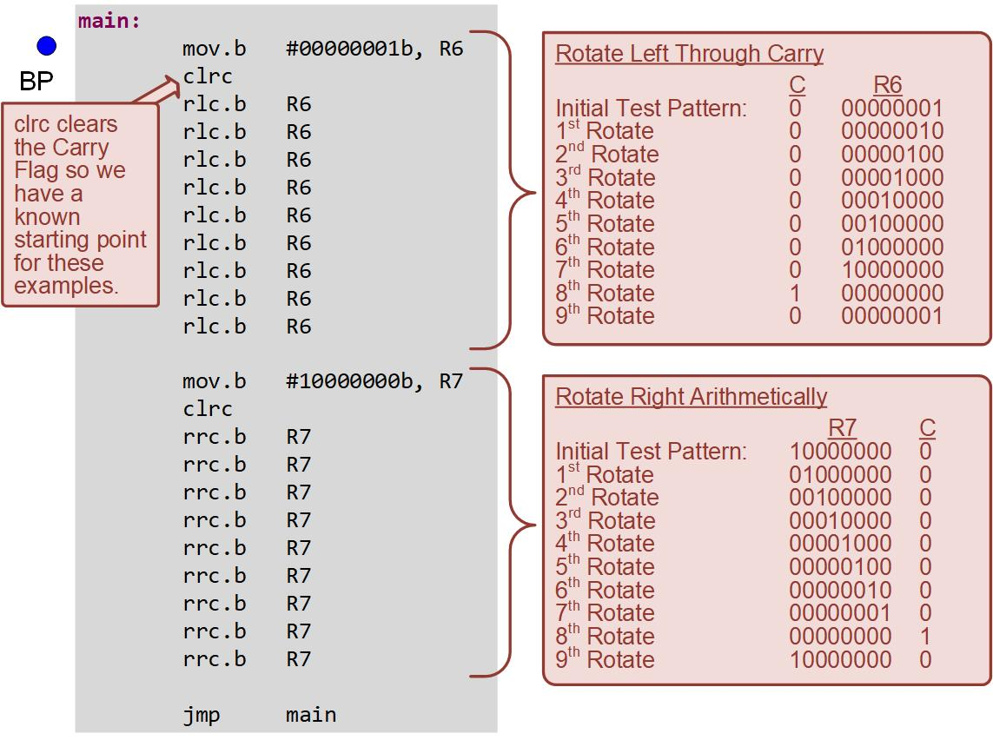
Ch. 7: Data Manipulation Instructions
Example: Using Rotate Through Carry
7.5 Rotate Operations

Slide 91
Ch. 7: Data Manipulation Instructions
Example: Using Rotate Through Carry
Step 3: Debug your program and correct any errors.
Step 4: Set a breakpoint before the first instruction
mov.b #00000001b, R6
Step 5: Open the register viewer and expand the Core Registers item to see the CPU registers. Change the number format of R6 → R7 to binary. Expand SR so you can see the C-flag.
Image Courtesy of
Recording Connection of Canada
Image Courtesy of
Recording Connection of Canada
Image Courtesy of
Recording Connection of Canada
Image Courtesy of
Recording Connection of Canada
Image Courtesy of
Recording Connection of Canada
Image Courtesy of
Recording Connection of Canada
Image Courtesy of
Recording Connection of Canada
Image Courtesy of
Recording Connection of Canada
Image Courtesy of
Recording Connection of Canada
Image Courtesy of
Recording Connection of Canada
Image Courtesy of https://neodem.wp.horizon.ac.uk/
Image Courtesy of https://neodem.wp.horizon.ac.uk/
7.5 Rotate Operations

Slide 92
Ch. 7: Data Manipulation Instructions
Example: Using Rotate Through Carry
Step 6: Run your program to the breakpoint.
Step 7: Step your program to observe its operation.
Image Courtesy of
Recording Connection of Canada
Image Courtesy of
Recording Connection of Canada
Image Courtesy of
Recording Connection of Canada
Image Courtesy of
Recording Connection of Canada
Image Courtesy of
Recording Connection of Canada
Image Courtesy of
Recording Connection of Canada
Image Courtesy of
Recording Connection of Canada
Image Courtesy of
Recording Connection of Canada
Image Courtesy of
Recording Connection of Canada
Image Courtesy of
Recording Connection of Canada
Image Courtesy of https://neodem.wp.horizon.ac.uk/
Image Courtesy of https://neodem.wp.horizon.ac.uk/
7.5 Rotate Operations

Slide 93
Ch. 7: Data Manipulation Instructions
7.5 Rotate Operations
Rotate instructions - perform multiply/divide by two operations.
When a binary number is rotated to the left by one bit and the vacated LSB position is filled with a zero, it doubles the original value.
When a binary number is rotated to the right by one bit and the vacated MSB position is filled with a zero.
Image Courtesy of
Recording Connection of Canada
Image Courtesy of
Recording Connection of Canada
Image Courtesy of
Recording Connection of Canada
Image Courtesy of
Recording Connection of Canada
Image Courtesy of
Recording Connection of Canada
Image Courtesy of
Recording Connection of Canada
Image Courtesy of
Recording Connection of Canada
Image Courtesy of
Recording Connection of Canada
Image Courtesy of
Recording Connection of Canada
Image Courtesy of
Recording Connection of Canada
Image Courtesy of https://neodem.wp.horizon.ac.uk/
Image Courtesy of https://neodem.wp.horizon.ac.uk/
7.5 Rotate Operations

Slide 94
Ch. 7: Data Manipulation Instructions
Example: Using Rotate to Multiply and Divide by 2
Step 1: Create a new Empty Assembly-only project titled:
Asm_ALU_MUL2_DIV2
Step 2: Type in the following code into the main.asm file where the comments say “Main loop here.”
Image Courtesy of
Recording Connection of Canada
Image Courtesy of
Recording Connection of Canada
Image Courtesy of
Recording Connection of Canada
Image Courtesy of
Recording Connection of Canada
Image Courtesy of
Recording Connection of Canada
Image Courtesy of
Recording Connection of Canada
Image Courtesy of
Recording Connection of Canada
Image Courtesy of
Recording Connection of Canada
Image Courtesy of
Recording Connection of Canada
Image Courtesy of
Recording Connection of Canada
Image Courtesy of https://neodem.wp.horizon.ac.uk/
Image Courtesy of https://neodem.wp.horizon.ac.uk/
7.5 Rotate Operations

Slide 95
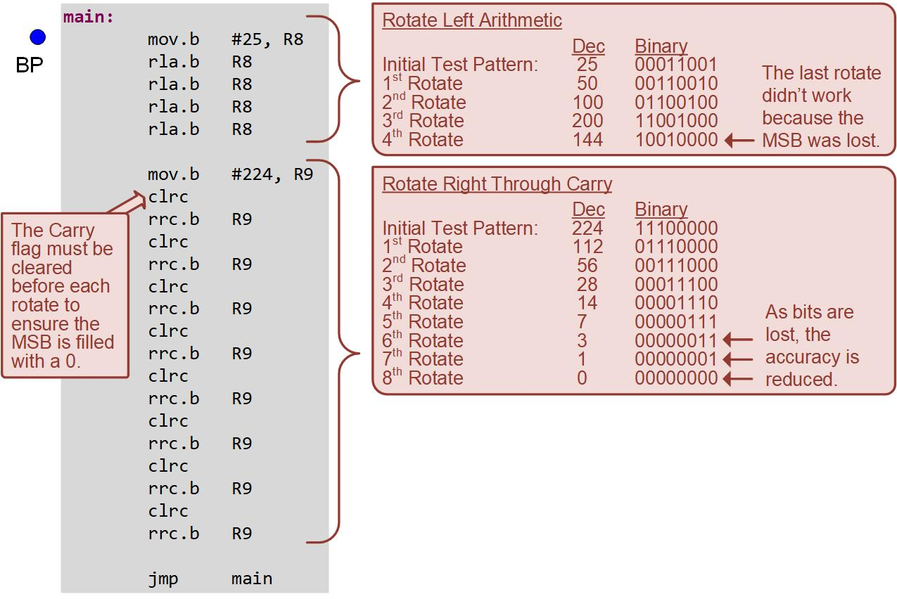
Ch. 7: Data Manipulation Instructions
Example: Using Rotate to Multiply and Divide by 2
7.5 Rotate Operations

Slide 96
Ch. 7: Data Manipulation Instructions
Example: Using Rotate to Multiply and Divide by 2
Step 3: Debug your program and correct any errors.
Step 4: Set a breakpoint before the first instruction
mov.b #25, R8
Step 5: Open the register viewer and expand the Core Registers item to see the CPU registers. Change the number format of R8 → R9 to decimal.
Image Courtesy of
Recording Connection of Canada
Image Courtesy of
Recording Connection of Canada
Image Courtesy of
Recording Connection of Canada
Image Courtesy of
Recording Connection of Canada
Image Courtesy of
Recording Connection of Canada
Image Courtesy of
Recording Connection of Canada
Image Courtesy of
Recording Connection of Canada
Image Courtesy of
Recording Connection of Canada
Image Courtesy of
Recording Connection of Canada
Image Courtesy of
Recording Connection of Canada
Image Courtesy of https://neodem.wp.horizon.ac.uk/
Image Courtesy of https://neodem.wp.horizon.ac.uk/
7.5 Rotate Operations

Slide 97

Ch. 7: Data Manipulation Instructions
Example: Using Rotate to Multiply and Divide by 2
Step 6: Run your program to the breakpoint.
Step 7: Step your program to observe its operation.
Image Courtesy of
Recording Connection of Canada
Image Courtesy of
Recording Connection of Canada
Image Courtesy of
Recording Connection of Canada
Image Courtesy of
Recording Connection of Canada
Image Courtesy of
Recording Connection of Canada
Image Courtesy of
Recording Connection of Canada
Image Courtesy of
Recording Connection of Canada
Image Courtesy of
Recording Connection of Canada
Image Courtesy of
Recording Connection of Canada
Image Courtesy of
Recording Connection of Canada
Image Courtesy of https://neodem.wp.horizon.ac.uk/
Image Courtesy of https://neodem.wp.horizon.ac.uk/
7.5 Rotate Operations

Slide 98
Embedded Systems Design
Chapter 7: Data Manipulation Instructions
7.5 Rotate Operations
www.youtube.com/c/DigitalLogicProgramming_LaMeres
Brock J. LaMeres, Ph.D.

